Slide 1
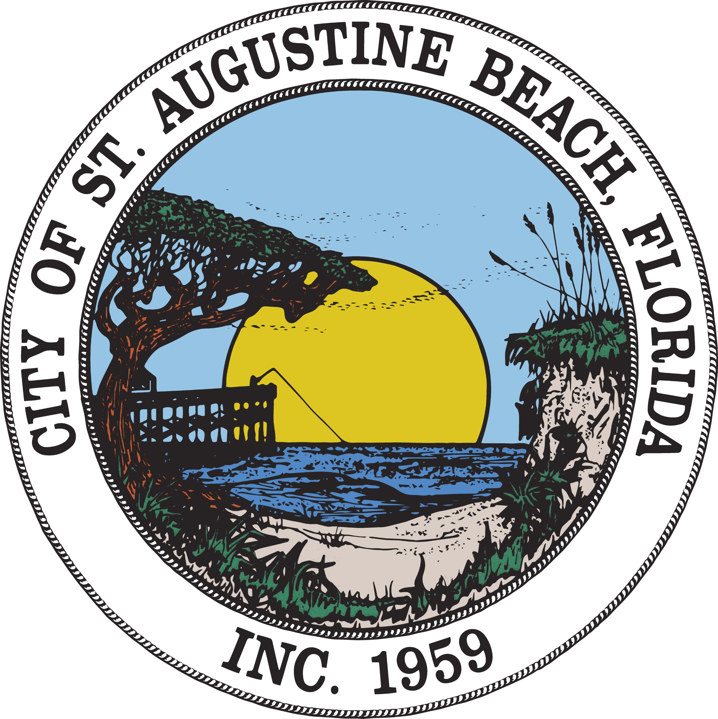
The NFIP & Flood Zones

Slide 2
The National Flood Insurance Program (NFIP) addresses flood risks in 3 ways: -risk mapping -mitigation -flood insurance

Slide 3
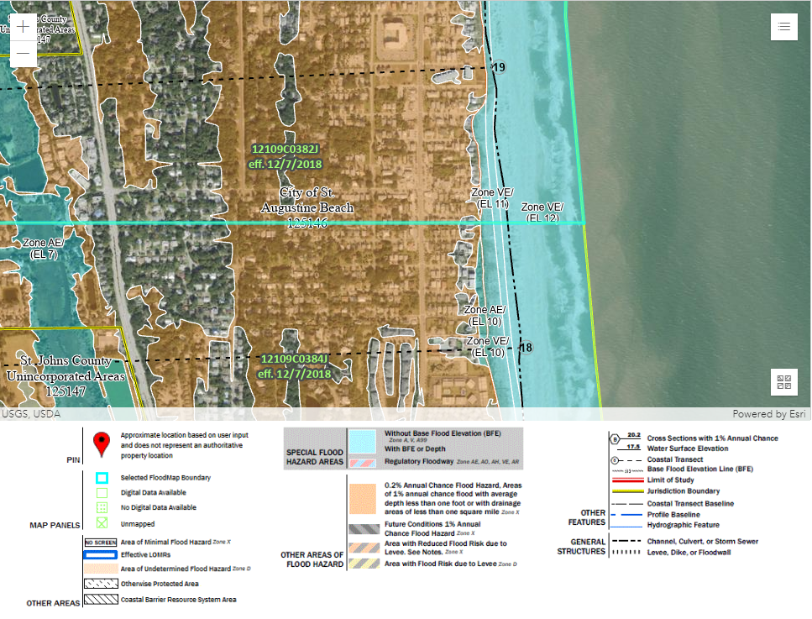
Risk Mapping:
Flood hazards are identified by mapping riverine and coastal areas.
Access Current FEMA Flood Maps here:
https://msc.fema.gov/portal/home

Slide 4
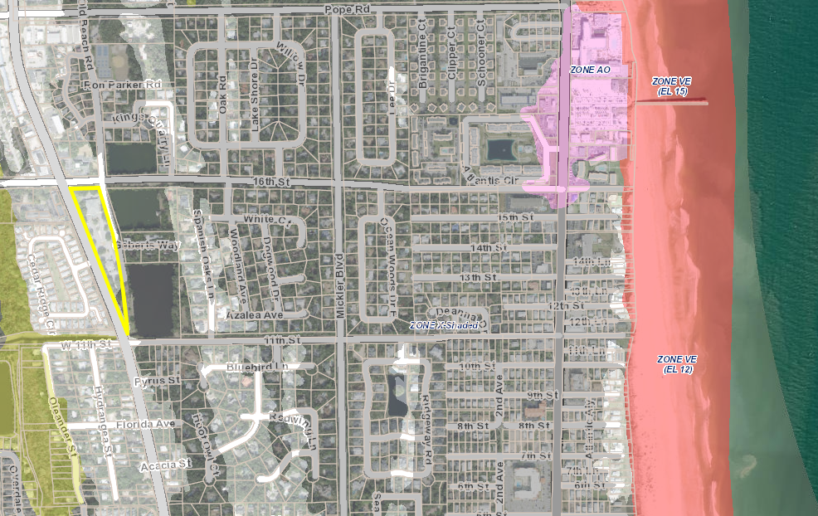
Risk Mapping: Find Your Flood Zone
Online: www.gis.sjcfl.us/floodviewer
Email : zoning@cityofsab.org
In Person

Slide 5
Tips for Mitigation:
When improving your home to mitigate for a flood, only hire licensed contractors. Do not hesitate to ask them for a copy of their contractor's license and liability/workers’ compensation insurance.
You may also call or email the City’s Building Department to see if a contactor is licensed and insured.
Phone: 904-471-8758
Email: onlinepermitting@cityofsab.org

Slide 6
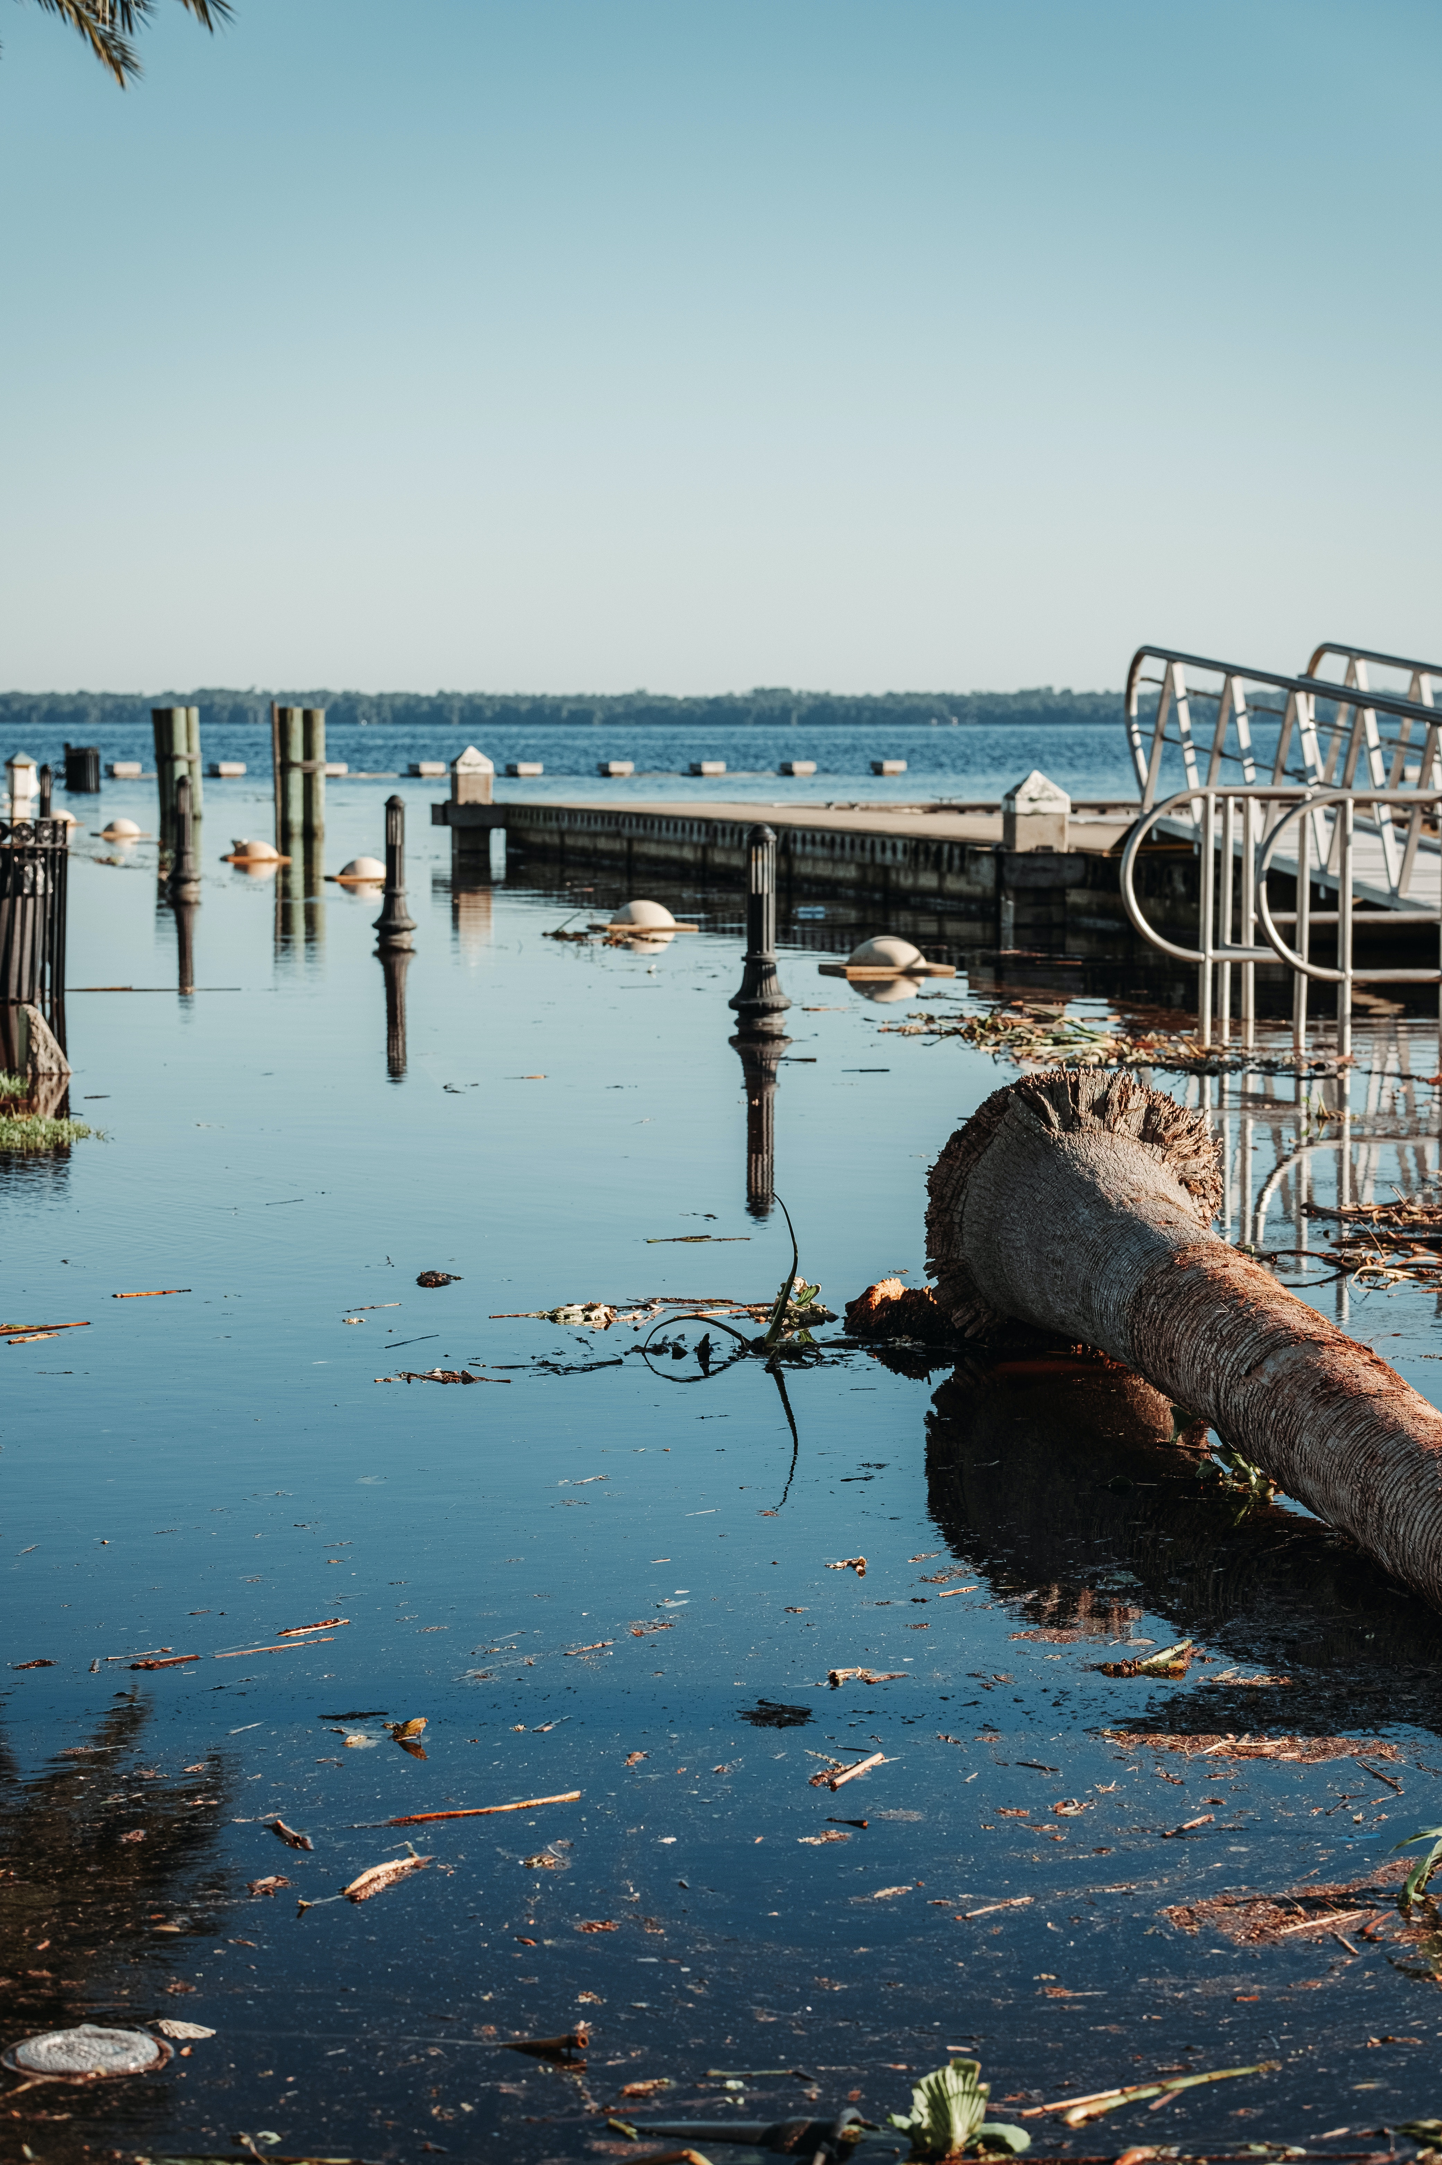
Flood Insurance:
The National Flood Insurance Program (NFIP) protects over 5 million policy holders from the financial losses that flooding can cause.

Slide 7
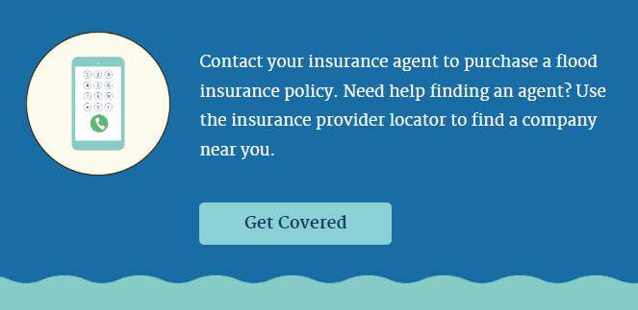
Did you know that your homeowner’s insurance does not cover a flood?
Obtain flood insurance through the NFIP to protect your home from a flood.
Visit:
https://www.floodsmart.gov/flood-insurance-provider

Slide 8
More Resources:
Fema.gov/flood-insurance

