Slide 1
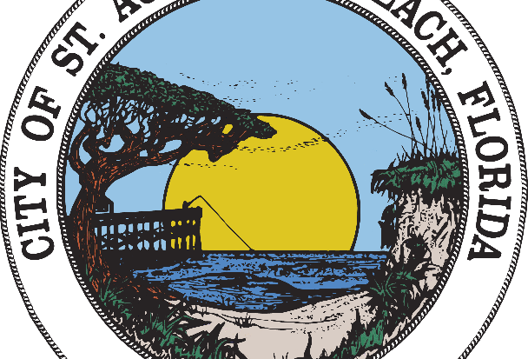
CITY OF ST. AUGUSTINE BEACH Hurricane Preparation & Our NPDES Program
Derek Sands, City Engineering Inspector

Slide 2
Hurricane Nicole 2022 – SR A1A

Slide 3
What Is NPDES?
“National Pollution Discharge Elimination System”
Program that helps address water pollution from three stormwater runoff sources:
Ditches, curbs, swales, catch basins, underground pipes, etc. – a.k.a. the Municipal Separate Storm Sewer Systems (MS4s)
Construction activities: home construction, road construction, commercial construction, etc.
Industrial activities: body shops, car washes, restaurants, etc.

Slide 4
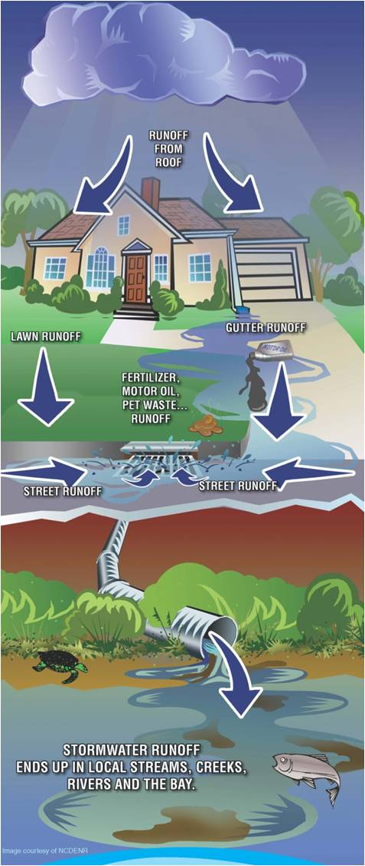
What is Stormwater Runoff?
Rain that does not soak into the ground is called “runoff”.
Runoff flows over land or impervious surfaces, such as paved streets, parking lots and building rooftops.
While flowing, runoff picks up pollutants like trash, chemicals, oils, and dirt/sediment.
Enters the storm drainage system and will eventually leads to local streams, creeks, rivers, Intracoastal waterways and even the ocean.

Slide 5
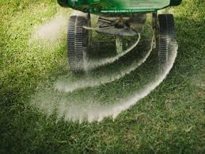
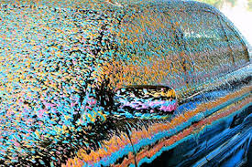
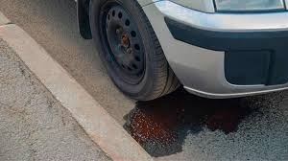
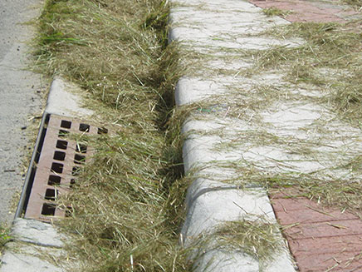
Common Types of Runoff Pollutants
Trash/Litter
Pet Waste
Lawn Chemicals
Cars Wash Chemicals
Motor-oil or Other Vehicle Related Fluids
Leftover Paint and Household Chemicals
Yard Clippings

Slide 6
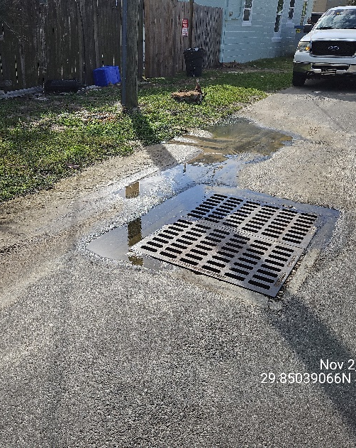
Illicit Discharges
Illicit discharges include any discharge into a storm drain system that is not entirely composed of stormwater.
Types of illicit discharge include:
Concrete or Paint Washouts
Water Hoses (e.g. pool dewatering)
Modified Trench Drains
Restaurant Waste (Grease, Garbage, Etc.)
Trash and Sewage

Slide 7
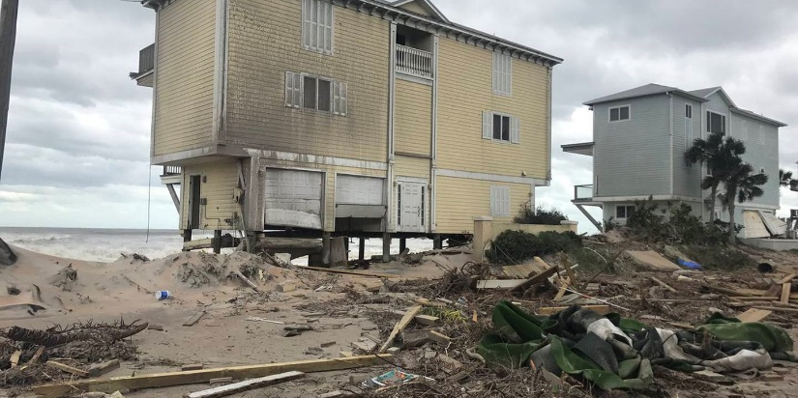
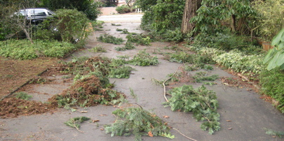
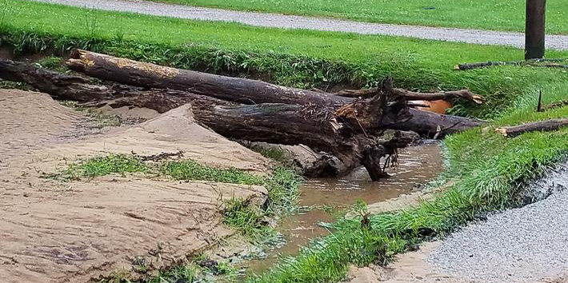
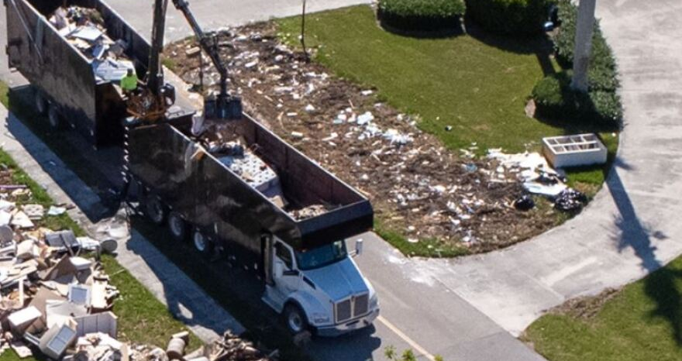
Storm Related Pollutants
Common Runoff Pollutants Plus…
Yard Debris
Construction Debris (from damaged buildings, walkways, docks, or other structures)

Slide 8
Pre- and Post- Storm Runoff & Illicit Discharge Impacts
Includes numerous pollutants, pathogens, nutrients, oils, sediments, etc. that can negatively impact stormwater systems before, during, and after storm events.
Pollutants such as yard debris, trash, concrete, paint, etc. can partially or completely clog stormwater systems and increase the risk of flooding or the decrease the ability of flood waters to recede.
Pollutants such as pathogens, chemicals, oils, etc. present in storm related standing water and can negatively affect animals, humans, homes, and vehicles that may be present in an affected area.

Slide 9
WHY DO WE CARE?
Debris and other contaminants can negatively affect our community before, during, and after storm events. (e.g. slowing First Responders, Public Works, making animals or humans sick, increase risk of flooding/standing water, etc.).
Whether we’re preparing for a storm or not, we should appreciate our beautiful natural water systems, and should always do our part to ensure they are preserved for our enjoyment and for generations to come.

Slide 10
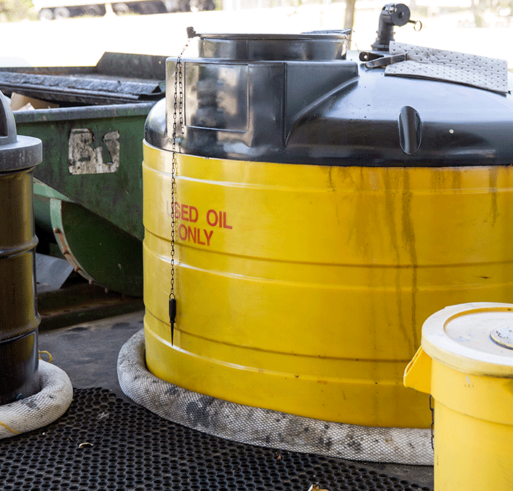
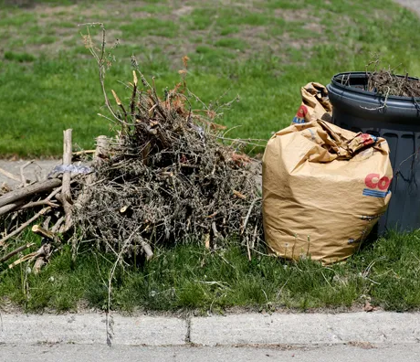
How Can We Prepare
Always ensure yard clippings and debris do not enter stormwater systems by blowing into the road, swale, or ditch.
Properly secure/dispose of motor oil or other vehicle related fluids.
Do not dump, pour, spill, or drop any sort of pollutants into our stormwater system (this includes driveways, sidewalks, streets, storm drains, etc.)
Immediately report stormwater pollution or questionable discharges to the storm sewer system or local waterways.

Slide 11
When to Report:
Odor | Causes
Rotten eggs/hydrogen sulfide | Raw sewage, decomposing organic matter, lack of oxygen
Sharp, pungent odor | Chemicals or pesticides
Gasoline, petroleum | Industrial discharge, illegal dumping of wastes, waste water
IF YOU SMELL…
Odors are an immediate indicator of some sort of pollution.

Slide 12
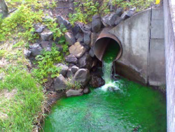
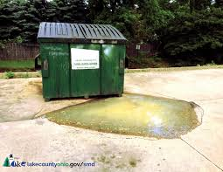
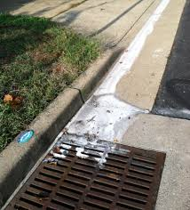
IF YOU SEE…

Slide 13
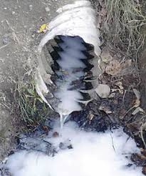
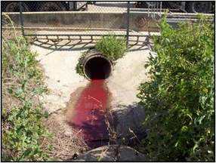
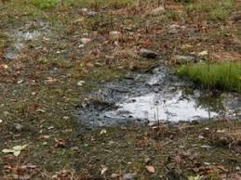
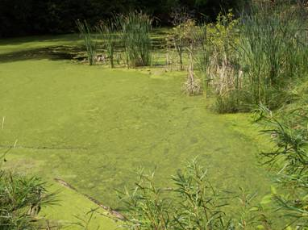

Slide 14
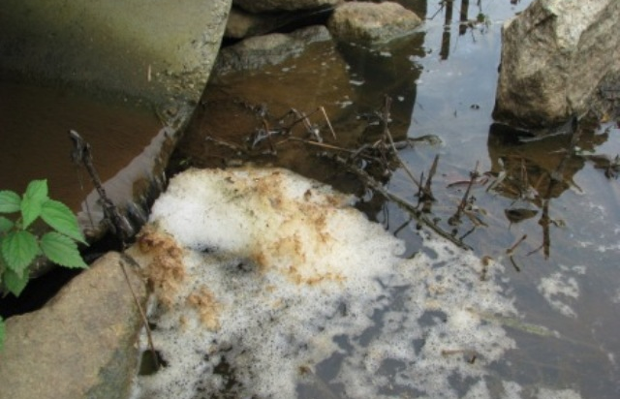
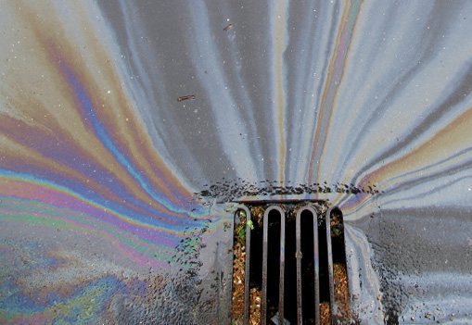
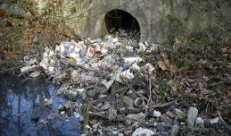
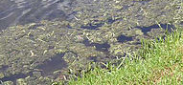

Slide 15
How To Report:
Call the City of St. Augustine Beach Public Works Department at (904) 471-1119
Email Public-Works@cityofsab.org
Use the City of St. Augustine Beach Resident Self-Service webpage that can be found at the bottom of any of our City project pages.
(City Page/Stormwater Management/Report Illegal Dumping)

Slide 16
Any Questions?

Slide 17
Words of Wisdom
“We forget that the water cycle and the life cycle are one.”
Jacques Cousteau

